Slide 1
OCTO-DE Impact Review:
Short Form
10-10 Health Apps team
Heather Justice - 10-10 Health Apps team - Product Manager
01/06/2023

Slide 2
Problem
10-10EZ Short Form - Impact Review, 01/06/2023
What Veteran-oriented problems did you attempt to solve?
Many Veterans are not completing the 10-10EZ Health Care Application, most likely due to either the time it takes to fill out the entirety of the application or lacking the additional information required to do so. We wanted to deliver an update to the form that would ease this time and information requirement so that we could expedite and simplify the application process; while reducing the number of applications that might be abandoned.
How does solving this problem contribute to OCTO-DE’s Objectives?
Providing an expedited application process for eligible Veterans will result in a better, simpler experience and quicker access to health care.
Increasing the percent of applications submitted online, by reducing the amount of time and cognitive effort to complete benefit use and enrollment, by making the application process accessible and uncomplicated for the Veteran | Decreasing call center volume, by making the application easy to understand time to complete and submit, by reducing the required information needed from the Veteran time to process applications, by working with the Veteran health eligibility center operations to review the shortened applications efficiently

Slide 3
Problem
10-10EZ Short Form - Impact Review, 01/06/2023
Why is solving this problem a priority vs. other problems?
Between 2020 and 2021, ~24.3k (2020) and ~34.2k (2021) applicants abandoned their Health Care Application within the Military or Household Information sections, so providing any means to bypass it will have a significant impact on Veterans. Since this change required little in the way of application changes, it was relatively fast and easy to do.
In several research sessions with Veterans, the main finding is that they feel the VA should already have much of the information that is being asked, especially the Military Information. There was also concern of how the information collected would be used, specifically information pertaining to a spouse’s financial details.
Timeframe | Applications abandoned | % of Applications abandoned vs started
2020 | 24.3k | 19.5% (124,353)
2021 | 34.2k | 12.8% (173,669)
What organizational challenges did you pursue?
While we know this change will benefit Veterans, we had to also ensure that our Enrollment Services teams could process these applications without the Military history and Household information, and not cause further delays or additional Veteran contact to obtain the missing information.
We worked with the Enrollment system team to coordinate system changes, and we worked with our Health Care Eligibility Center stakeholders to confirm processing steps are in place to receive and review the applications that will not include the information.

Slide 4
Hypotheses, Solutions
10-10EZ Short Form - Impact Review, 01/06/2023
Hypotheses
Veterans who are eligible to skip the Military Information and Household Information sections are much more likely to complete their application
Solution(s)
Identify a set of criteria that can be used to determine whether a Veteran can skip the Military Information and Household Information sections
To accomplish this, we worked with our VA Stakeholders and the OCTO-DE Product Owner to identify which fields could possibly be omitted from the application and the situation(s) in which we could omit them. It was determined that if a Veteran had a service-connected Disability Rating of >=50%, the Military Information and the Household Information sections could be skipped, either because the information was already available or was simply unnecessary. Incidentally, the Household Information section has the highest exit rate of the entire application.
For those that meet the criteria, present a shortened form for them to complete.

Slide 5
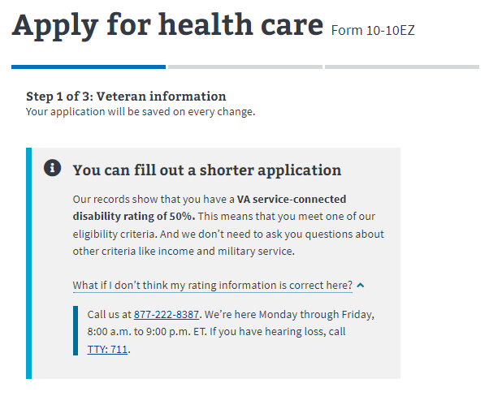
Messaging for authenticated Veterans:
10-10EZ Short Form - Impact Review, 01/06/2023

Slide 6
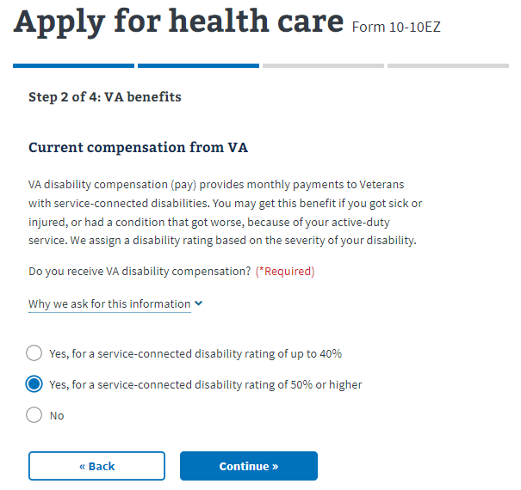
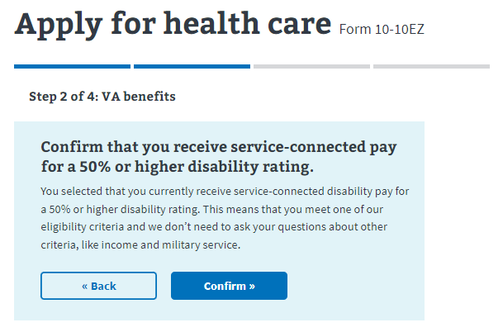
Messaging - Self-reporting (authenticated or unauthenticated):
10-10EZ Short Form - Impact Review, 01/06/2023

Slide 7
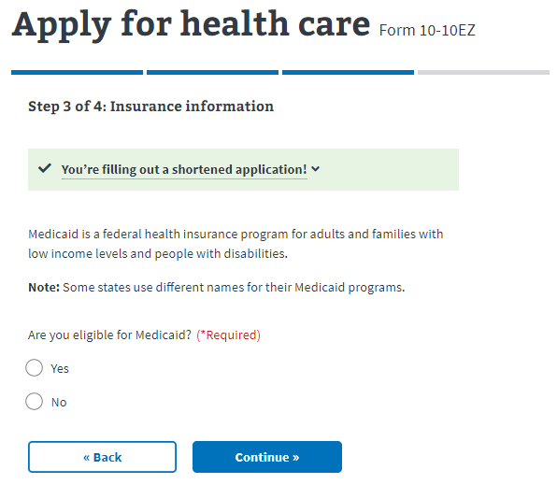
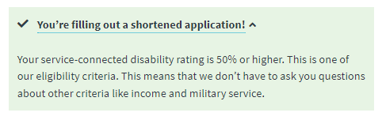
Messaging with information (displayed on each page following initial notice):
10-10EZ Short Form - Impact Review, 01/06/2023

Slide 8
Results
10-10EZ Short Form - Impact Review, 01/06/2023
Launch date:
09/19/2022 (to 5% of applicants)
10/17/2022 (to 25% of applicants)
10/24/2022 (to 50% of applicants)
10/26/2022 (to 75% of applicants)
10/31/2022 (to 100% of applicants)
Impact on Users, Business, and/or Technology
The Veteran healthcare application is shortened for those Veterans that have greater than 50% disability rating, reducing the cognitive effort by skipping sections of the application that are not necessary for them to complete
The Health Care Eligibility Center teams are able to receive applications faster for those Veterans who have greater than 50% disability rating, and can quickly assess them for health care enrollment.
Quantitative
Less abandonments
Less number of sessions to submit
Qualitative
Veterans have expressed how “super easy” the application process is
Short-form eligible Veterans have been surprised at the brevity of the application, and agree that it is “straight-forward” and “simple”
Feedback trend indicates that there does not seem to be any stopping points where a Veteran would need to stop, and return to complete the application at another time.

Slide 9
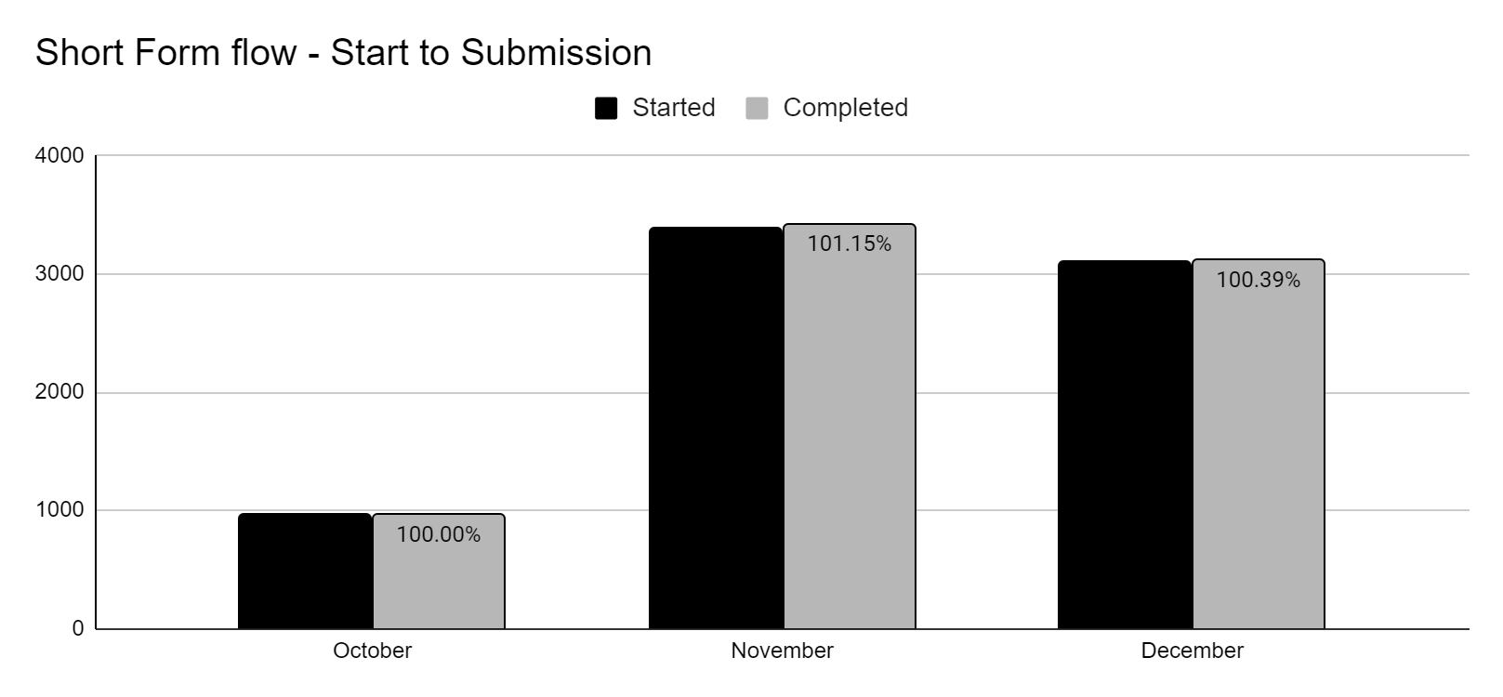
Results
10-10EZ Short Form - Impact Review, 01/06/2023
Key Result: Target 30% of application submissions to be through Short Form flow
KPI / Metric | Post-launch October (phased launch) | Post-launch November | Post-launch December
Total applications submitted | 11,292 | 10,878 | 10,343
Short Form applications submitted | 961 | 3,421 | 3,114
Pct. Short Form Applications | 8.37% | 31.45% | 30.08%
Notes:
Short Form applications holding steady around 30% of total applications submitted
Number of Short Form applications being started each month are being submitted consistently, including some older applications not yet submitted (feature was live in July and September for short time periods)

Slide 10
Results
10-10EZ Short Form - Impact Review, 01/06/2023
Key Result: Increase number of application submissions
KPI / Metric | Baseline: Jan-June 2022 (average) | Post-launch November | Post-launch December
Application starts per Month | 21,264 | 17,509 | 15,124
Submissions per Month | 13,034 | 10,878 | 10,343
Pct. Applications Completed | 61.3% | 62.1% | 68.4%
Key Result: Reduce Sessions / Time taken to complete application
KPI / Metric | Baseline: Jan-June 2022 (average) | Post-launch November | Post-launch December
Avg. Sessions per Submission | 1.52 | 1.44 | 1.43
Avg. Single sessions per Month | 8,103 | 7,126 | 6,808
Avg. 2 sessions per Month | 2,857 | 1,940 | 1,800
Avg. 3 or more sessions per Month | 1,764 | 763 | 733
Notes:
Upward trend on percent of applications being started and subsequently submitted
Downward trend on number of sessions it takes to complete and submit the application

Slide 11
Results
10-10EZ Short Form - Impact Review, 01/06/2023
Key Result: Reduce abandoned applications
KPI / Metric | Baseline: Jan-June 2022 (6 mo avg) | Post-launch November | Post-launch December
Applications Abandoned per month | 40% (8,638 of 21,605 started) | 38% (6,631 of 17,509 started) | 32% (4,781 of 15,124 started)
Military and Household sections abandoned compared to total abandoned | 12% (1,061 of 8,638 abandoned) | 26% (1,765 of 6,631 abandoned) | 38% (1,835 of 4,781 abandoned)
What is happening here?
While we can see a clear reduction in overall abandonment rates, we see that the number of abandoned applications within the Military and Household sections have remained steady, slightly increasing, and account for a larger share of the total abandoned applications.
Notes:
Downward trend on overall abandonment rates
Steady incline of abandonments percentage within the Military and Household sections

Slide 12
10-10 Health Apps Team
10-10EZ Short Form - Impact Review, 01/06/2023
Heather Justice, Product Manager
Mark Fallows, Associate Product Manager
Lisa Zapson, Frontend Engineer
Matt Long, Frontend Engineer
Lihan Li, Backend Engineer
Nick Osmanski, Designer
Jessica Stump, Design and research
Past Team Members
Dene Gabaldon, Design and research
Sharon Kasimow, Product Manager

Slide 13
Open Discussion
1010EZ Short Form - Impact Review, 01/06/2023
Recommendations
Continue to review the Household section for optimization to reduce the cognitive load and points of confusion mentioned in past research sessions.
Research sessions wrapped up in December, findings will be reviewed with HEC Stakeholders 1/18.
Notes
Notes:
We are currently reviewing the Household section, which asks for spouse, dependent and financial information. We have just wrapped up research in December and are preparing to present our findings to the stakeholders in a couple weeks.
We believe that we can reorganize and reframe some of the questions along with clarifying text, and this will help Veterans be better prepared and able to provide the information without having to stop and return later to complete.

Slide 14
1010EZ Short Form - Impact Review, 01/06/2023
Executive Summary
Problem and why it was important to solve problem
Many Veterans are not completing the 10-10EZ Health Care Application, most likely due to either the time it takes to fill out the entirety of the application or lacking the additional information required to do so. We wanted to deliver an update to the form that would ease this time and information requirement so that we could expedite and simplify the application process; while reducing the number of applications that might be abandoned.
Between 2020 and 2021, ~24.3k (2020) and ~34.2k (2021) applicants abandoned their Health Care Application within the Military or Household Information sections, so providing any means to bypass it will have a significant impact on Veterans.
Hypotheses
Veterans who are eligible to skip the Military Information and Household Information sections are much more likely to complete their application
Quantitative Results
Averaging 30% of application submissions are through Short Form flow
Application submissions have increased from a 6-month average of 61% of started applications to 68% in December
Average sessions to submit decreased from 1.52 to 1.43
Applications abandoned decreased from 40% to 32% of started applications
Recommendations
Continue to review the Household section for optimization to reduce the cognitive load and points of confusion mentioned in past research sessions.

Slide 15
Start here
<Initiative> Impact Review, DD/MM/YY
Please maintain the slide style, fonts, and formatting when crafting your deck.
Fill in your name, team and date in Slide 1’s footer.
Every slide after Slide 1 needs a title and the <Initiative> Impact Review, DD/MM/YY header.
Answer bolded questions.
Consider (and then delete) italicized questions.
Charts, graphs, and images need captions, titles and axis labels.
Add a thin border to any visuals and make sure it fits on the slide entirely (see Slide 4 for an example).
Executive Summary slide can be populated in advance but plan to complete it immediately following the presentation, adding any pearls from the discussion.
Remove any blank slides.

